Slide 1


Struts Core

Slide 2
Agenda
StrutsCore Introductory Session
  By Logan Machakalai
StrutsCore - A Quick Start
  By FBMI Team
Notes:
By Using the Factory Design Pattern, new logging facilities can be added with code changes
By using Websphere JRAS Logging/Tracing, all messages are written to same file in same format. This is extremely help in debugging problems.

Slide 3
Topics Covered
- Logan Machakalai
  Why Struts Core
  What’s Unique about Struts Core
  Token Synchronization
  Struts Core – A Quick Start
    by FBMI Team

Slide 4
Why Struts Core
    Early Projects – Issues
    Examples :-
      Authorization Handling
      Exception Handling
      Validation
    Struts Core Highlights
      Abstraction / Base Layer Code
      Consistent Approach

Slide 5
Whats Unique about Struts Core
    Form Lookup dispatch method
    Populate Form Bean before displaying the screen
    Form should always be specified at Session Scope
    Transaction initiation from Form Bean
    Default Method is “HttpGet”
    Default Parameter value is “method”

Slide 6
Token Synchronization
    Need of Token Synchronization
      Clicking more than once on a submit control
      Using refresh button
      Using the browser back button to resubmit form
      Using browser history feature and re-submit form
      Malicious submissions to the server
    Key Methods for Token Synchronization
      saveToken(HttpServletRequest req)
      isTokenValid(HttpServletRequest req)
      resetToken(HttpServletRequest req)

Slide 7
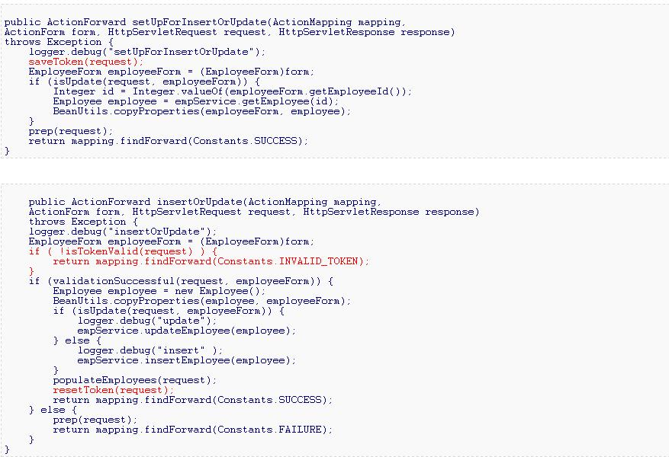
Token Synchronization – An Example

Slide 8
Struts Core - A Quick Start

Slide 9
Welcome !
FBMI Team
  Senthil Kumar
  Senthil Raman
  Vishwanathan Rajaram
  Katchapakesan Thamotharan
  Abdul Rahim Khan.

Slide 10
Topics Covered
- FBMI Team
Goal
Struts Core : Where does it fit into Ford Architecture.
Brief Summary of StrutsCore Functionalities
Initial Setup
  Required Jars
  Configuration Files
  Config Files Demo
Getting Started – Detailed Explanation with Code Examples
  Establish Base Classes
  Inherited Functionality
  Usage Patterns
  Navigation Flow Demo
  Logging & Exceptions
  Authorization
  Session Expiry
Lessons learned
Questions
Notes:
By Using the Factory Design Pattern, new logging facilities can be added with code changes
By using Websphere JRAS Logging/Tracing, all messages are written to same file in same format. This is extremely help in debugging problems.

Slide 11
Our Goal
Is to get you quick-started on StrutsCore
  Understand how to set it up
  Understand how to use it
For a deeper understanding, we recommend
  Software Design Guide
  Struts Core User Guide
  Struts Core Source Code & Javadoc
  JAB application Code to study usage
Notes:
By Using the Factory Design Pattern, new logging facilities can be added with code changes
By using Websphere JRAS Logging/Tracing, all messages are written to same file in same format. This is extremely help in debugging problems.

Slide 12
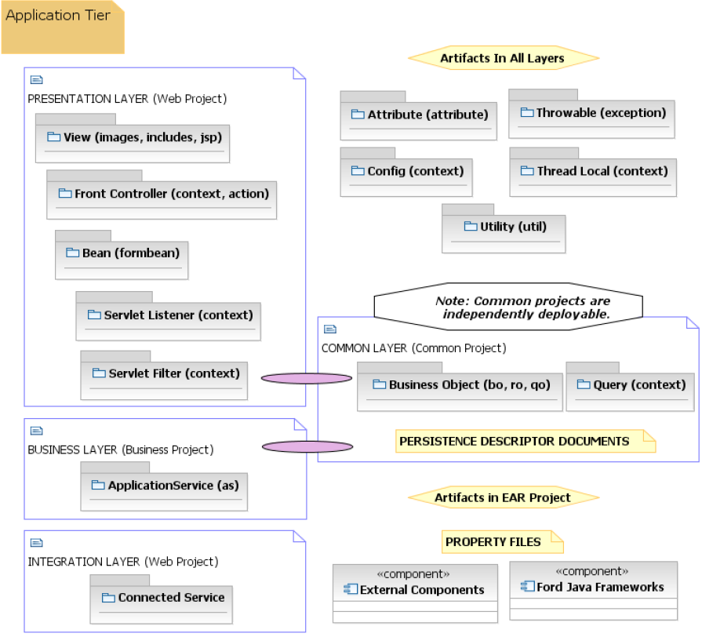
Ford’s 4-Layer Architecture

Slide 13
Ford’s 4-Layer Architecture
S
t
r
u
t
s
C
o
r
e

Slide 14
Ford Frameworks
APIs contextualized for Ford environment.
To suit Ford’s requirements.
Incorporate Ford’s best practices & conventions.
  StrutsCore
  ITCore
  PersistenceCore
  WsCore
Notes:
By Using the Factory Design Pattern, new logging facilities can be added with code changes
By using Websphere JRAS Logging/Tracing, all messages are written to same file in same format. This is extremely help in debugging problems.

Slide 15
StrutsCore Functions
Lookup Dispatch Form Processing
Chained Action Support for Navigation
Default Button Support
Validation – linking buttons to specific validations
Exceptions
Logging of StrutsCore Lifecycle
Limited API exposure
Pattern Enforcement of Coding Conventions
Token Synchronization
Authorization
Session Expiry
Internationalization
Notes:
By Using the Factory Design Pattern, new logging facilities can be added with code changes
By using Websphere JRAS Logging/Tracing, all messages are written to same file in same format. This is extremely help in debugging problems.

Slide 16
Initial Setup
Configure a server on RSA using Desktop Configurator.
JAB is Ford’s own J2EE Reference Implementation.
Two ways of setting up a new project:
  Import the complete JAB application into your RSA workspace
  Copy the JAB folder structure & import jars as reqd.
Notes:
Mimic JDK 1.4 logging because this will become the industry standard. This will require less training in the long run.
Allow for pluggable logging facilities so we can use the best logger for the job

Slide 17
Required Jars in WEB-INF/lib
strutscore-fjf.jar
struts-core-1.x.x.jar
    struts-el-1.x.x.jar
    struts-extras-1.x.x.jar
    struts-faces-1.x.x.jar
    struts-scripting-1.x.x.jar
    struts-mailreader-dao-1.x.x.jar
    struts-taglib-1.x.x.jar
    struts-tiles-1.x.x.jar
itcore.jar
commons-validator-1.x.x.jar
commons-lang-2.x.jar
Notes:
Mimic JDK 1.4 logging because this will become the industry standard. This will require less training in the long run.
Allow for pluggable logging facilities so we can use the best logger for the job

Slide 18
Links
StrutsCore https://www.tc2.ford.com/ts/JCOE/Java%20Technologies%20Wiki/StrutsCore.aspx
JAB
  http://wwwqa.jab.ford.com/JCOEAdventureBuilderStrutsWeb/authenticatePre.do
Notes:
Mimic JDK 1.4 logging because this will become the industry standard. This will require less training in the long run.
Allow for pluggable logging facilities so we can use the best logger for the job

Slide 19
Configuration Files
struts-config.xml
strutscore-config.xml
fjf-security-plugins-config.xml
web.xml
tiles-def.xml
applicationResources.properties
Notes:
By Using the Factory Design Pattern, new logging facilities can be added with code changes
By using Websphere JRAS Logging/Tracing, all messages are written to same file in same format. This is extremely help in debugging problems.

Slide 20
struts-config.xml
Register Request Processor
Form Declarations
ActionMappings
  scope=“session”
  validate=“true”/”false”
Notes:
By Using the Factory Design Pattern, new logging facilities can be added with code changes
By using Websphere JRAS Logging/Tracing, all messages are written to same file in same format. This is extremely help in debugging problems.

Slide 21
strutscore-config.xml
Register TestCase
Turn Validation On/Off
Turn Logging On/Off
Register Authorization Provider
Notes:
By Using the Factory Design Pattern, new logging facilities can be added with code changes
By using Websphere JRAS Logging/Tracing, all messages are written to same file in same format. This is extremely help in debugging problems.

Slide 22
fjf-security-plugins-config.xml
<property-group name="AuthorizationProviderFactory">
<property-group name ="APSSecurityPluginConfig">
<property name="appName">JABDEV</property>
<property name="class">com.ford.jcoe.jab.util.JabAuthorizationProviderFactory
</property>
<property name="apsConfigFile">aps_config.xml</property>
</property-group>
<property name="default">
com.ford.jcoe.jab.util.JabAuthorizationProviderFactory
</property>
<property-group name="menu">
<property name="class">com.ford.jcoe.jab.util.JabAuthorizationProviderFactory</property>
</property-group>
</property-group>
Notes:
By Using the Factory Design Pattern, new logging facilities can be added with code changes
By using Websphere JRAS Logging/Tracing, all messages are written to same file in same format. This is extremely help in debugging problems.

Slide 23
web.xml
Register RequestContext Filter
Load strutscore-config.xml
  using ScConfigInitializer
Load fjf-security-plugins-config.xml
  using AuthorizationInitializer
Notes:
By Using the Factory Design Pattern, new logging facilities can be added with code changes
By using Websphere JRAS Logging/Tracing, all messages are written to same file in same format. This is extremely help in debugging problems.

Slide 24
tiles-def.xml
<definition name="layout" path="/jsp/layout/layout.jsp">
<put name="title" value="JAB" type="string" />
<put name="mainJSInclude" value="/jsp/include/mainJSInclude.jsp" />
<put name="customJSInclude" value="" type="string" />
<put name="header" value="/jsp/layout/header.jsp" />
<put name="body" value="${body}" />
<put name="footer" value="/jsp/layout/footer.jsp" />
</definition>
<definition name="tile.home" extends="layout">
<put name="title" value="JAB - HomePage" type="string" />
<put name="pageName" value="home" type="string" />
<put name="pageLabel" value="label.home.homePage" type="string" />
<put name="pageAction" value="homePagePre.do" type="string" />
<put name="pageParent" value="" type="string" />
<put name="body" value="/jsp/view/home.jsp" />
</definition>
Notes:
By Using the Factory Design Pattern, new logging facilities can be added with code changes
By using Websphere JRAS Logging/Tracing, all messages are written to same file in same format. This is extremely help in debugging problems.

Slide 25
ApplicationResources.properties
Buttons
  button.strutscore.httpGet.default=httpGet
  button.strutscore.cancel.default=Cancel
  button.searchBooking=Search
Labels
  label.home.actions=Actions
  label.home.adventure=Adventure
Messages
  errors.required={0} is required.
Notes:
By Using the Factory Design Pattern, new logging facilities can be added with code changes
By using Websphere JRAS Logging/Tracing, all messages are written to same file in same format. This is extremely help in debugging problems.

Slide 26
Config Files Demo
Run through all config files
Show console trace on startup
Notes:
By Using the Factory Design Pattern, new logging facilities can be added with code changes
By using Websphere JRAS Logging/Tracing, all messages are written to same file in same format. This is extremely help in debugging problems.

Slide 27
Getting Started
Establish Base Classes
Inherited Functionality
Usage Patterns
Logging & Exceptions
Navigation Flow Demo
Notes:
By Using the Factory Design Pattern, new logging facilities can be added with code changes
By using Websphere JRAS Logging/Tracing, all messages are written to same file in same format. This is extremely help in debugging problems.

Slide 28
Establish Base Classes
JabRequestProcessor extends ScTilesRequestProcessor
JabBaseForm extends ScBaseLDForm
JabBaseBeginAction extends ScBaseBeginAction
JabBasePreAction extends ScBasePreAction
JabBasePostAction extends ScBasePostAction
JabBaseAjaxAction extends ScBaseAjaxAction
JabBaseLogoutAction extends ScBaseLogoutAction
Place all common functionality in Base Classes
Notes:
By Using the Factory Design Pattern, new logging facilities can be added with code changes
By using Websphere JRAS Logging/Tracing, all messages are written to same file in same format. This is extremely help in debugging problems.

Slide 29
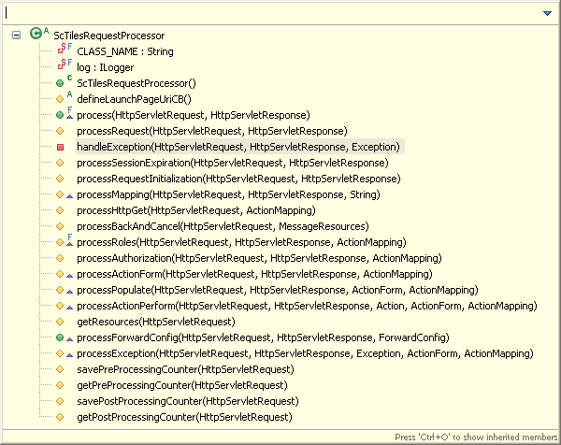
JabRequestProcessor : Inherited Functionality
JabRequestProcessor extends ScTilesRequestProcessor
ScTilesRequestProcessor extends TilesRequestProcessor
  process()
  processRequest()
  processRoles
  processAuthorization()
  processActionPerform()
  processPopulate()
  defineLaunchPageUriCB()
Notes:
By Using the Factory Design Pattern, new logging facilities can be added with code changes
By using Websphere JRAS Logging/Tracing, all messages are written to same file in same format. This is extremely help in debugging problems.

Slide 30
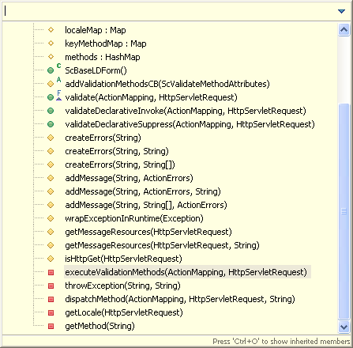
Forms : Inherited Functionality
SearchForm extends JabBaseForm
JabBaseForm extends ScBaseLDForm
ScBaseLDForm extends ValidatorActionForm
  keyMethodMap;
  addValidationMethodsCB()
  validate()
  executeValidationMethods()
Notes:
By Using the Factory Design Pattern, new logging facilities can be added with code changes
By using Websphere JRAS Logging/Tracing, all messages are written to same file in same format. This is extremely help in debugging problems.

Slide 31
Forms : Usage
getter()
setter()
populate()
  Populate screen with data from backend
  (BOs directly linked to jsp form elements)
  Call service layer directly
process()
  Process submitted data
  Save data to backend.
  Call service layer directly
validate()
  Validate submitted data
Notes:
By Using the Factory Design Pattern, new logging facilities can be added with code changes
By using Websphere JRAS Logging/Tracing, all messages are written to same file in same format. This is extremely help in debugging problems.

Slide 32
Form.validate(): Usage
Naming Convention to connect a button name with a form method
  validate<ButtonName>()
Validation Options for every button
  Invoke declarative validation(s)
  Invoke programmatic validation(s)
  Invoke both declarative and programmatic validations
  Invoke Suppress validations

Slide 33
Actions : Inherited Functionality
JabBaseBeginAction extends ScBaseBeginAction
ScBaseBeginAction extends ScBaseLDAction
  clearFormsFromSession()
  clearAllFormsFromSession()
  Enforces Coding Convention
  if (!this.getClass().getName().endsWith("BeginAction")) {
  throw new ScCodingConventionException(
  new FordExceptionAttributes.Builder(
  CLASS_NAME, METHOD_NAME).build(),
  "The class name [" + this.getClass().getName()
  + "] does *not* end with 'BeginAction'.");
ScBaseLDAction extends LookupDispatchAction
Notes:
By Using the Factory Design Pattern, new logging facilities can be added with code changes
By using Websphere JRAS Logging/Tracing, all messages are written to same file in same format. This is extremely help in debugging problems.

Slide 34
ScBaseLDAction : Inherited Functionality
ScBaseLDAction extends LookupDispatchAction
  getKeyMethodMap()
  addNavigateMethodsCB()
  navigateBack()
  navigateBackChained()
  navigateCancel()
  navigateNo
  navigateHttpGet()
  createMessages
  dispatchMethod()
Notes:
By Using the Factory Design Pattern, new logging facilities can be added with code changes
By using Websphere JRAS Logging/Tracing, all messages are written to same file in same format. This is extremely help in debugging problems.

Slide 35
BeginAction : Usage
addNavigateMethodsCB()
    Register button name(Search) with method names
navigateHttpGet()
  Forward to PreAction
Clear Forms from session
Notes:
By Using the Factory Design Pattern, new logging facilities can be added with code changes
By using Websphere JRAS Logging/Tracing, all messages are written to same file in same format. This is extremely help in debugging problems.

Slide 36
Request Flow
User
Request
Response
FW
Browser
Action Servlet
Clear stale forms from session
BeginAction.do
Request Processor
Struts-config
Notes:
Mimic JDK 1.4 logging because this will become the industry standard. This will require less training in the long run.
Allow for pluggable logging facilities so we can use the best logger for the job

Slide 37
Request Flow
User
Request
Response
FW
Browser
Populate
PreAction.do
ServiceAS
Action Servlet
BeginAction.do
Persistence layer
Request Processor
Clear stale forms from session
Struts-config
Db
Notes:
Mimic JDK 1.4 logging because this will become the industry standard. This will require less training in the long run.
Allow for pluggable logging facilities so we can use the best logger for the job

Slide 38
PreAction : Usage
addNavigateMethodsCB()
    Register button name(Search) with method names
navigateSearch()
  Call populate()
Naming Convention to connect a button name with an action method
  navigateSearchButtonName()
Notes:
By Using the Factory Design Pattern, new logging facilities can be added with code changes
By using Websphere JRAS Logging/Tracing, all messages are written to same file in same format. This is extremely help in debugging problems.

Slide 39
Request Flow
User
Request
Response
FW
Browser
Populate
PreAction.do
ServiceAS
Action Servlet
Persistence layer
Request Processor
Struts-config
Db
Notes:
Mimic JDK 1.4 logging because this will become the industry standard. This will require less training in the long run.
Allow for pluggable logging facilities so we can use the best logger for the job

Slide 40
PostAction : Usage
addNavigateMethodsCB()
    Register button name(Search) with method names
navigateSearch()
  Call process()
Naming Convention to connect a button name with an action method
  navigate<ButtonName>()
Notes:
By Using the Factory Design Pattern, new logging facilities can be added with code changes
By using Websphere JRAS Logging/Tracing, all messages are written to same file in same format. This is extremely help in debugging problems.

Slide 41
Request Flow
User
Request
Response
FW
Browser
ServiceAS
Action Servlet
Process/save
PostAction.do
Persistence layer
Request Processor
Struts-config
Db
Notes:
Mimic JDK 1.4 logging because this will become the industry standard. This will require less training in the long run.
Allow for pluggable logging facilities so we can use the best logger for the job

Slide 42
Chained Request Flow
User
Request
Response
FW
Browser
Populate
PreAction.do
ServiceAS
Action Servlet
Process/save
PostAction.do
Persistence layer
Request Processor
Struts-config
Db
Notes:
Mimic JDK 1.4 logging because this will become the industry standard. This will require less training in the long run.
Allow for pluggable logging facilities so we can use the best logger for the job

Slide 43
StrutsCore Functions
Lookup Dispatch Form Processing
Chained Action Support for Navigation
Default Button Support
Validation – linking buttons to specific validations
Exceptions
Logging of StrutsCore Lifecycle
Limited API exposure
Pattern Enforcement of Coding Conventions
Token Synchronization
Authorization
Session Expiry
Internationalization
Notes:
By Using the Factory Design Pattern, new logging facilities can be added with code changes
By using Websphere JRAS Logging/Tracing, all messages are written to same file in same format. This is extremely help in debugging problems.

Slide 44
Code Demo
How does a button click on a jsp page, materialize into a Struts Core application flow?
Notes:
By Using the Factory Design Pattern, new logging facilities can be added with code changes
By using Websphere JRAS Logging/Tracing, all messages are written to same file in same format. This is extremely help in debugging problems.

Slide 45
Button-to-Action Navigation Flow
Authenticate.jsp
  <bean:message key="button.enterAsAgent" />
JabConstant
  button.enterAsAgent=Enter As Agent
  ENTER_AS_AGENT_RB_KEY = "button.enterAsAgent";
  NAVIGATE_AS_AGENT = "navigateAsAgent";
Notes:
By Using the Factory Design Pattern, new logging facilities can be added with code changes
By using Websphere JRAS Logging/Tracing, all messages are written to same file in same format. This is extremely help in debugging problems.

Slide 46
Button-to-Action Navigation Flow
protected void addNavigateMethodsCB(
ScNavigateMethodAttributes navigateMethodAttributes) {
String METHOD_NAME = "addNavigateMethodsCB";
log.entering(CLASS_NAME, METHOD_NAME);
navigateMethodAttributes.add(
        JabConstant.ENTER_AS_AGENT_RB_KEY,
JabConstant.NAVIGATE_AS_AGENT);
navigateMethodAttributes.add(
JabConstant.ENTER_AS_DEFAULT_CUSTOMER_RB_KEY,
JabConstant.NAVIGATE_AS_DEFAULT_CUSTOMER);
navigateMethodAttributes.add(JabConstant.ENTER_AS_CUSTOMER_RB_KEY,
JabConstant.NAVIGATE_AS_CUSTOMER);
log.exiting(CLASS_NAME, METHOD_NAME);
return;
}
Notes:
By Using the Factory Design Pattern, new logging facilities can be added with code changes
By using Websphere JRAS Logging/Tracing, all messages are written to same file in same format. This is extremely help in debugging problems.

Slide 47
Button-to-Action Navigation Flow
Action.navigateAsAgent()
{
searchForm.populateCustomers();
// searchForm.processBooking();
}

Slide 48
Logging & Exceptions
Base functionality for both provided by ITCore.
ScCodingConventionException extends ScRuntimeException
ScRuntimeException extends FordSelfLoggingRuntimeException
Struts Core logs all life cycle events.
Notes:
Mimic JDK 1.4 logging because this will become the industry standard. This will require less training in the long run.
Allow for pluggable logging facilities so we can use the best logger for the job

Slide 49
Authorization
Request Authorization
  Declarative Authorization of an Action
View Authorization
  JSP Tags
Direct Programmatic Invocation
  Utility Functions

Slide 50
Request Authorization
Declarative Authorization of an Action
  <action path="/createBookingStep1Pre“
  type=“com.ford.jcoe.jab.action.create.CreateBookingStep1
  PreAction" name="bookingForm" scope="session"
  validate="false“ parameter="method"
  roles=“CreateBooking:execute()” >

Slide 51
View Authorization
JSP Tags
  IsAuthorizedForAnyTag
    <sc:isAuthorizedForAny authorizationString=“yourAuthString">
  IsAuthorizedForAllTag
  NotAuthorizedForAllTag
  NotAuthorizedForAnyTag

Slide 52
Direct Programmatic Invocation
Utility Functions
  ScUtilAuthorization.isAuthorizedForAll()
  ScUtilAuthorization.isAuthorizedForAny()
  ScUtilAuthorization.notAuthorizedForAll()
  ScUtilAuthorization.notAuthorizedForAny()

Slide 53
View Authorization
<!-- Authorized Agent-->
<sc:isAuthorizedForAny authorizationString="agent">
<div id="user_id">
<ul>
<li>Welcome! (<%=request.getUserPrincipal()%>)</li>
<li>Booking Agent: jabagent</li>
<li><a href="<%=request.getContextPath() %>/logout.do">Logout</a></li>
</ul>
</div>
</sc:isAuthorizedForAny>
<!-- Authorized Customer-->
<sc:isAuthorizedForAny authorizationString="customer">
<div id="user_id">
<ul>
<li>Welcome! (<%=request.getUserPrincipal()%>)</li>
<li>Customer: <%=RequestContext.getLocalInstance().getUserId("unknown")%></li>
<li><a href="<%=request.getContextPath() %>/logout.do">Logout</a></li>
</ul>
</div>
</sc:isAuthorizedForAny>

Slide 54
Session Expiry
At Ford, the default session expiration timeout is 20 minutes.
Session expiration can be controlled using SESSION_INVALIDATION_TIME attribute in application.jacl file.

Slide 55
Session Expiry sample
Session Expiry can be set in application.jacl file As follows:
## Definition: This parameter specifies how long(in minutes) a session is
## allowed to go unused before Websphere marks it for cleanup.
## Note: The value is in minutes.
## If not overridden here, it will default to 20
## IMPORTANT: THIS VALUE SHOULD NOT EXCEED 20. BECAUSE,
## IN THE FORD LOAD BALANCED ENVIRONMENT, THE LOAD BALANCER HAS THE
## STICKY BIT TIMEOUT SETTING TO 20 MINUTES. THIS MEANS THAT AFTER
## 20 MINUTES OF INACTIVITY THE LOAD BALANCER COULD SEND THE NEXT
## REQUEST TO A DIFFERENT WEB SERVER WHICH COULD THEN SEND THE REQUEST TO A
## DIFFERENT WEBSPHERE INSTANCE.
#set SESSION_INVALIDATION_TIME "20"

Slide 56
StrutsCore Functions
Lookup Dispatch Form Processing
Chained Action Support for Navigation
Default Button Support
Validation – linking buttons to specific validations
Exceptions
Logging of StrutsCore Lifecycle
Limited API exposure
Pattern Enforcement of Coding Conventions
Token Synchronization
Authorization
Session Expiry
Internationalization
Notes:
By Using the Factory Design Pattern, new logging facilities can be added with code changes
By using Websphere JRAS Logging/Tracing, all messages are written to same file in same format. This is extremely help in debugging problems.

Slide 57
Lessons Learnt
At least 1 week – 10 days required
  to go through JAB code
  understand usage patterns
  link up & understand other frameworks API
  build a dummy application / page.
Took us 2 weeks to try to figure out navigation / validation, as we kept putting it off.
Nested BOs values display on JSP gave us some problems.
Persistence Core
  We mixed up QOs, BOs & ROs usage.
  BO update: We did everything, except merge the object before commit.
Notes:
Mimic JDK 1.4 logging because this will become the industry standard. This will require less training in the long run.
Allow for pluggable logging facilities so we can use the best logger for the job

Slide 58

JCOE!
Thank you
  Logan Machakalai
  Pratyusha Yenamandala
for all the encouragement & review inputs.
FBMI Team
  Senthil Kumar
  Senthil Raman
  Vishwanathan Rajaram
  Katchapakesan Thamotharan
  Abdul Rahim Khan

